Slide 1

Workshop Inkscape 2017
#2
Masjid Al Falah, Yeongdeungpo Seoul
download materinya di https://github.com/superpikar/inkscape-workshop-2017
oleh : @superpikar

Slide 2

Apakah Laptop + Mouse sudah ada? Inkscape sudah terinstal?
sebelum memulai...

Slide 3





Siapa saya?
A. Dzulfikar Adi Putra
Baca cerpen dan koding javascript
Web/mobile app developer
http://pikarlabs.com
superpikar

Slide 4









Slide 5
Review Pertemuan 2
Teori
Tipografi
Kombinasi warna
Layout dokumen
Praktek
Seleksi objek
Group and ungroup
Object position
Align and distributes
Shadow & Blur
Clipping
Color gradient
Path
Object to path
Tugas

Slide 6
Materi pertemuan 3
Teori
Kalibrasi Monitor
Inkscape untuk percetakan
Praktek
Path
Object to path
Tracing bitmap
Text follow path
Layer
Duplicate, clone, copy/paste?
Mengulang pola/objek
Setting brosur lipat 3
Tugas

Slide 7

Teori
Beberapa teori dasar desain

Slide 8
Kalibrasi Monitor
The Lagom LCD monitor test pages are an excellent resource for calibrating your monitor manually. The process isn’t as in-depth and precise as using a colorimeter would be, but in my opinion the results are acceptable^{[5]}.

Slide 9
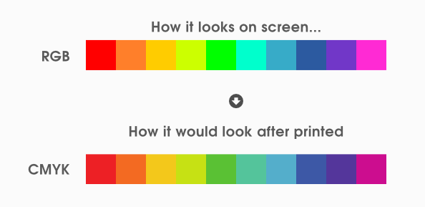
Inkscape untuk percetakan
For Inkscape to be accepted in the print world, there must be good reliable support for both RGBA and CMYK color spaces. At the moment, the easiest way to get Inkscape SVG into CMYK color spaces is via import into Scribus or using Acrobat Distiller on Win32. Export to eps and conversion using perl script pscol from http://dionysos.mpch-mainz.mpg.de/~joeckel/pscol/ is also possible^{[4]} .
There are two main reasons why Inkscape fails in the prepress department: Firstly, while it can export various PDF standards, it does not support the de-facto prepress printing standard PDF/X-3. Secondly, and more importantly, Inkscape is not able to embed color profiles in exported PDFs^{[2]} .

Slide 10
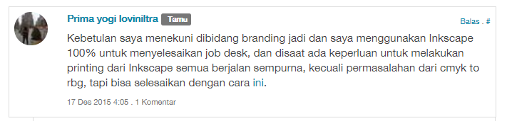
Inkscape untuk percetakan
Dari sisi lainnya, ada yang mempermasalahkan redupnya warna, warna yang kurang sesuai dengan desain aslinya, dikarenakan standar warna untuk produksi cetak adalah CMYK sedangkan aplikasi Inkscape tidak mendukung color palette CMYK atau masih memakai color palette RGB. Untuk masalah ini, ada beberapa solusi yang ditawarkan seperti konversi warna file Inkscape dari RGB ke CMYK dengan Scribus yang merupakan aplikasi khusus publishing dan ada juga dengan menggunakan tool CMYKTool seperti yang dipublis oleh fedoraproject.org disini http://fedoraproject.org/wiki/How_to_set_CMYK_color_on_a_design_for_printing .

Slide 11

Mari Praktek!

Slide 12
Path
a
seleksi multi objek

Slide 13
Object to Path
a
seleksi multi objek

Slide 14
Text Follow Path
a
seleksi multi objek

Slide 15
Tracing Bitmap
a
seleksi multi objek

Slide 16
Layer
a
seleksi multi objek

Slide 17
Duplicate, clone, copy/paste?
a
seleksi multi objek

Slide 18
Mengulang pola/objek
a
seleksi multi objek

Slide 19
Setting brosur lipat 3
a
seleksi multi objek

Slide 20

Tugas!

Slide 21
Tugas!
Anda bebas berkreasi untuk tugas kali ini
Jenis x : a
Teknik yang harus digunakan :
Object to Path
Path
Text Follow Path
Mengulang Pola Objek
Brosur lipat 3

Slide 22
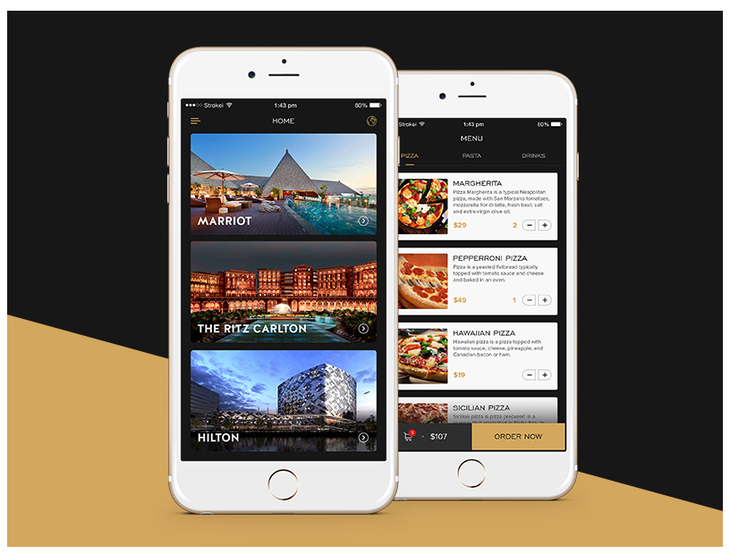
Contoh Tugas : Mobile App Design
sumber : https://dribbble.com/shots/3963825-Hotel-App

Slide 23


Contoh Tugas : Cartoon design
sumber : https://dribbble.com/siegemedia

Slide 24


Contoh Tugas : Brosur lipat 3
sumber : https://dribbble.com/artbart

Slide 25
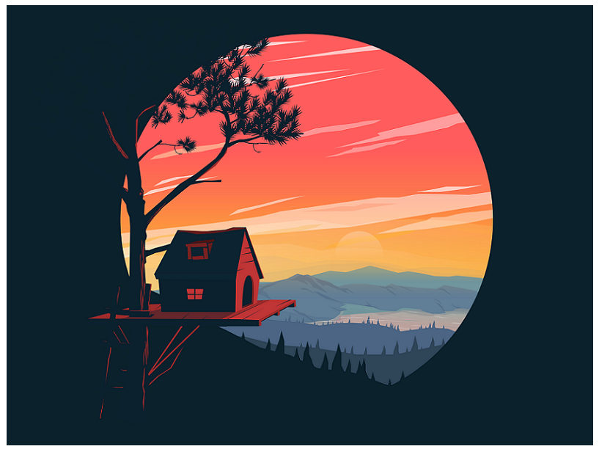



Contoh Tugas : Ikon bebas
sumber : https://dribbble.com/ozant

Slide 26
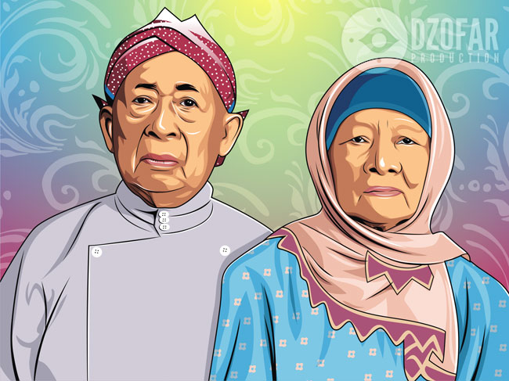
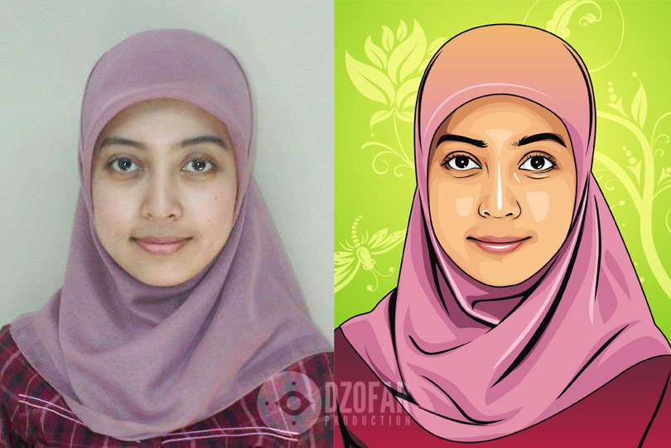
Contoh Tugas : Manual Tracing
sumber : https://ndop.deviantart.com/gallery/

Slide 27






Contoh Tugas : Logo proposal (minimal 3 logo)
sumber : https://dribbble.com/vadimcarazan

Slide 28
Referensi
https://graphicdesign.stackexchange.com/questions/60200/inkscape-svg-%E2%86%92-print-ready-eps-pdf-workflow
http://www.klaasnotfound.com/2016/06/05/creating-cmyk-prepress-pdfs-with-inkscape-and-scribus/
https://logosbynick.com/designing-print-ready-business-cards-in-inkscape/
http://wiki.inkscape.org/wiki/index.php/Color_management
http://www.lagom.nl/lcd-test/
http://fedoraproject.org/wiki/How_to_set_CMYK_color_on_a_design_for_printing
https://kelaskita.com/adi-cahyadi-16/kelas/inkscape-indonesia/
https://ismailtaufiq.wordpress.com/2014/05/25/warna-redup-hasil-cetak-file-inkscape/
https://poesinkje.blogspot.kr/2016/05/cara-setting-cmyk-desain-inkscape-untuk.html
https://graphicdesign.stackexchange.com/questions/56480/exporting-from-indesign-for-print-pdf-jpeg-or-png

